Slide 1
Microeconomics for Business
Chapter 13 – Externalities and Public Goods
Public Goods

Slide 2
Public Goods
Question for the Class
What goods should the government provide?

Slide 3
Public Goods
What is a public good?
“it is a good provided by the government.”

Slide 4
Public Goods
In economics, a public good is defined as a good (or service) that is both non-exclusive and non-rival.

Slide 5
Public Goods
Non-exclusive means that, once this good is provided to someone, the producer cannot exclude other individuals from consuming this good.

Slide 6
Public Goods
Non-exclusive means that, once this good is provided to someone, the producer cannot exclude other individuals from consuming this good.
radio station airing a program

Slide 7
Public Goods
Non-exclusive means that, once this good is provided to someone, the producer cannot exclude other individuals from consuming this good.
radio station airing a program
products in a supermarket
non-exclusive
exclusive

Slide 8
Public Goods
Non-rival means that, once the producer is providing the good to one customer, the marginal cost of providing the public good to another consumer is essentially zero, at any level of provision.

Slide 9
Public Goods
Non-rival means that, once the producer is providing the good to one customer, the marginal cost of providing the public good to another consumer is essentially zero, at any level of provision.
Empty Public Park
products in a supermarket
non-rival
rival

Slide 10
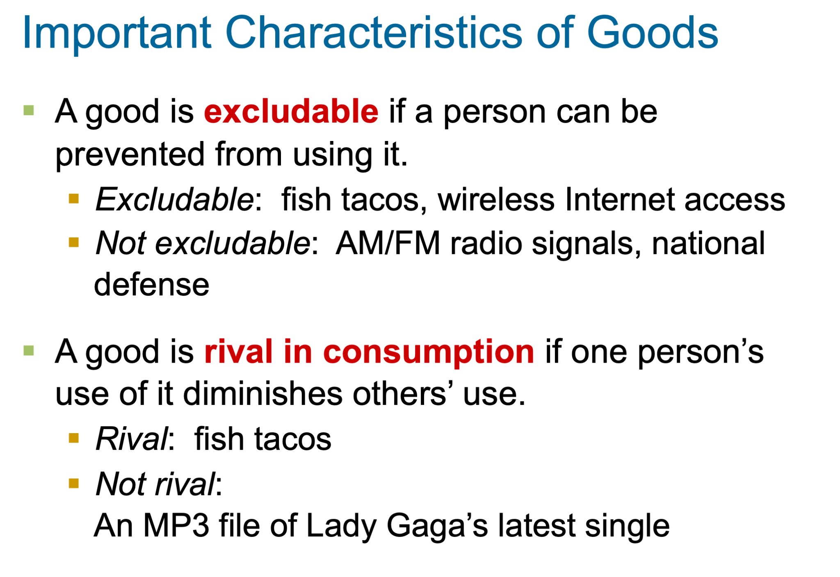

Slide 11
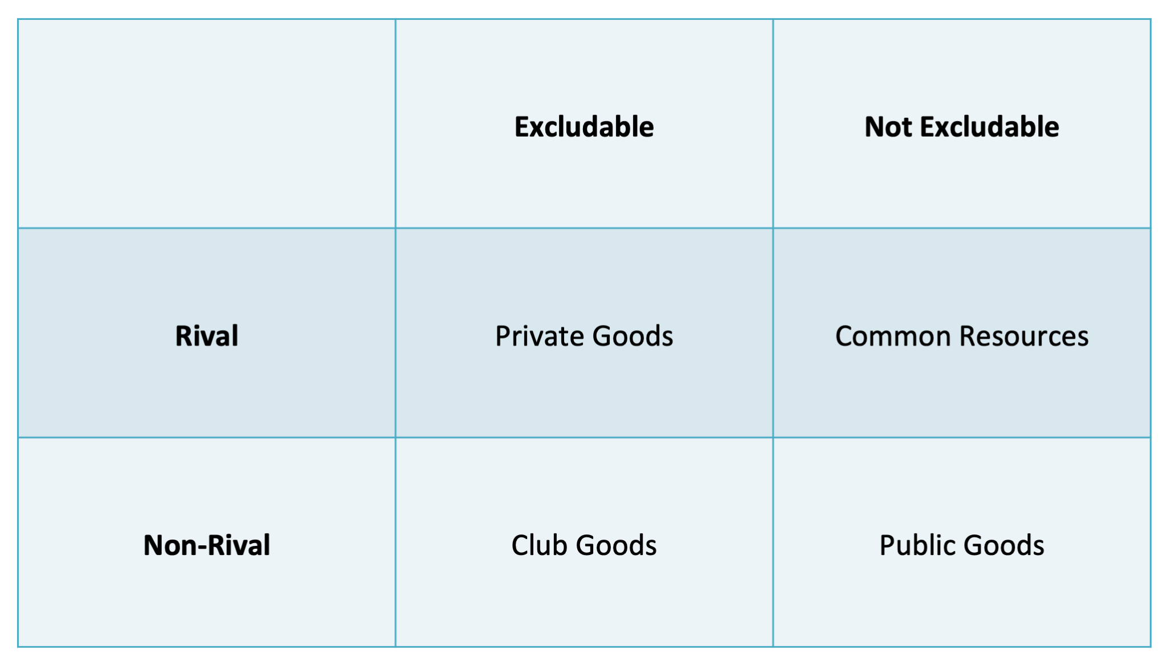

Slide 12
PUBLIC GOODS
https://mru.org/courses/principles-economics-microeconomics/public-goods-example-asteroid-defense

Slide 13
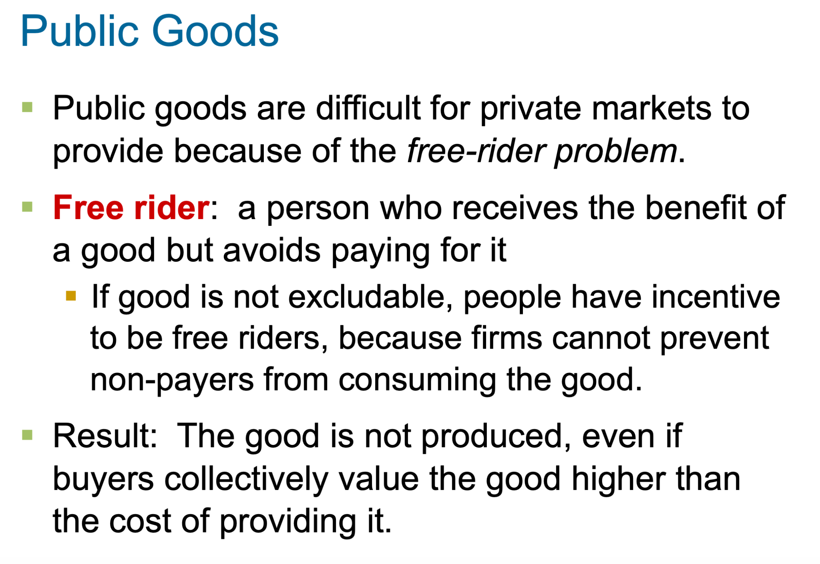

Slide 14
Public Goods
EXAMPLE–
Public Broadcast program
Any consumer can free-ride (can listen to the program for free and leave it to others to pay for the product).

Slide 15
Public Goods (Solutions)
Find a Different Customer
Because of its public good nature, the radio station survives not by charging a monetary price from listeners, but by charging advertisers.
Make the Good Excludable
Satellite radio signals that are scrambled and require an authorized equipment to listen to the programs are exclusive.
Have the Government produce it

Slide 16
Public Goods
A classic example of public good is national defense.

Slide 17
Public Goods
A classic example of public good is national defense.
A huge free-rider problem would occur if the head of the national defense went door to door asking people to voluntarily pay for this service.

Slide 18
Public Goods
A classic example of public good is national defense.
A huge free-rider problem would occur if the head of the national defense went door to door asking people to voluntarily pay for this service.
The government imposes a tax and forces people to pay for national defense.

Slide 19
Public Goods examples
National Defense
Police/Legal System
Public Parks
Basic Research

Slide 20
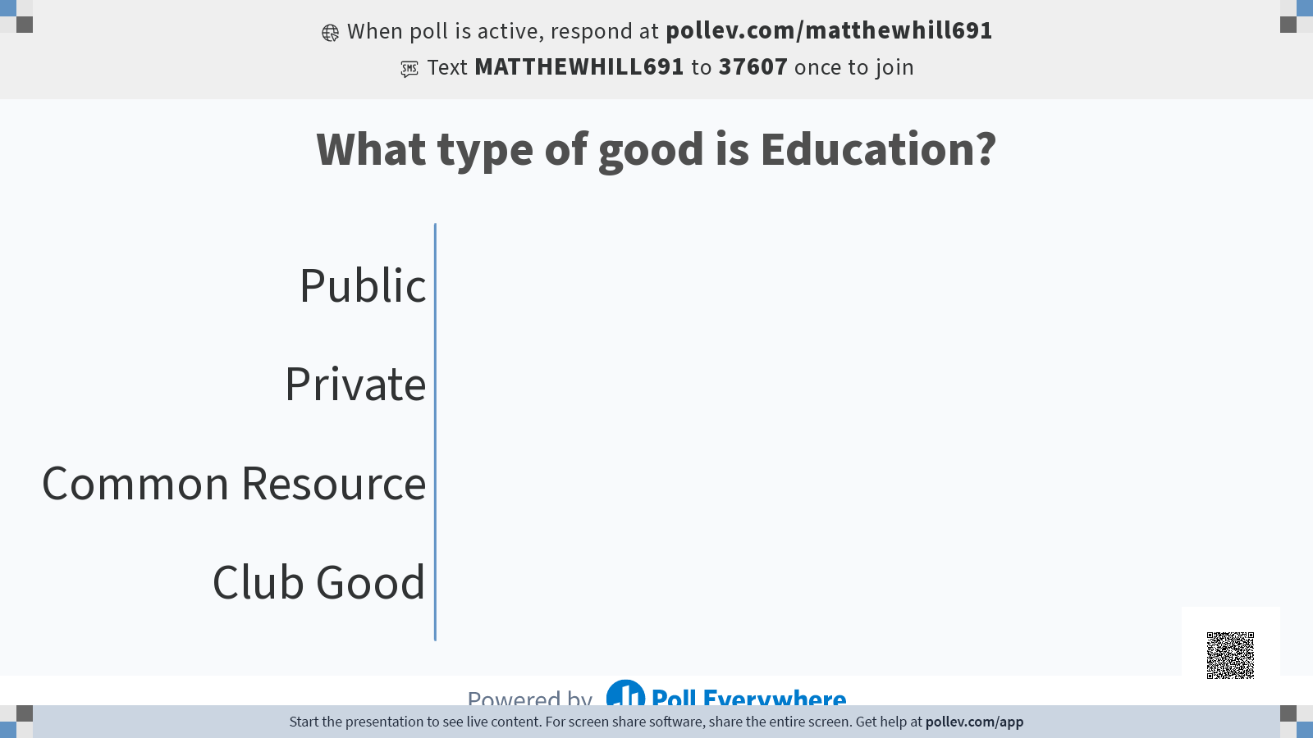

Slide 21
Public Goods
The educational service provided by public schools is not a public good according to our definition. Education is both rival and excludable.

Slide 22
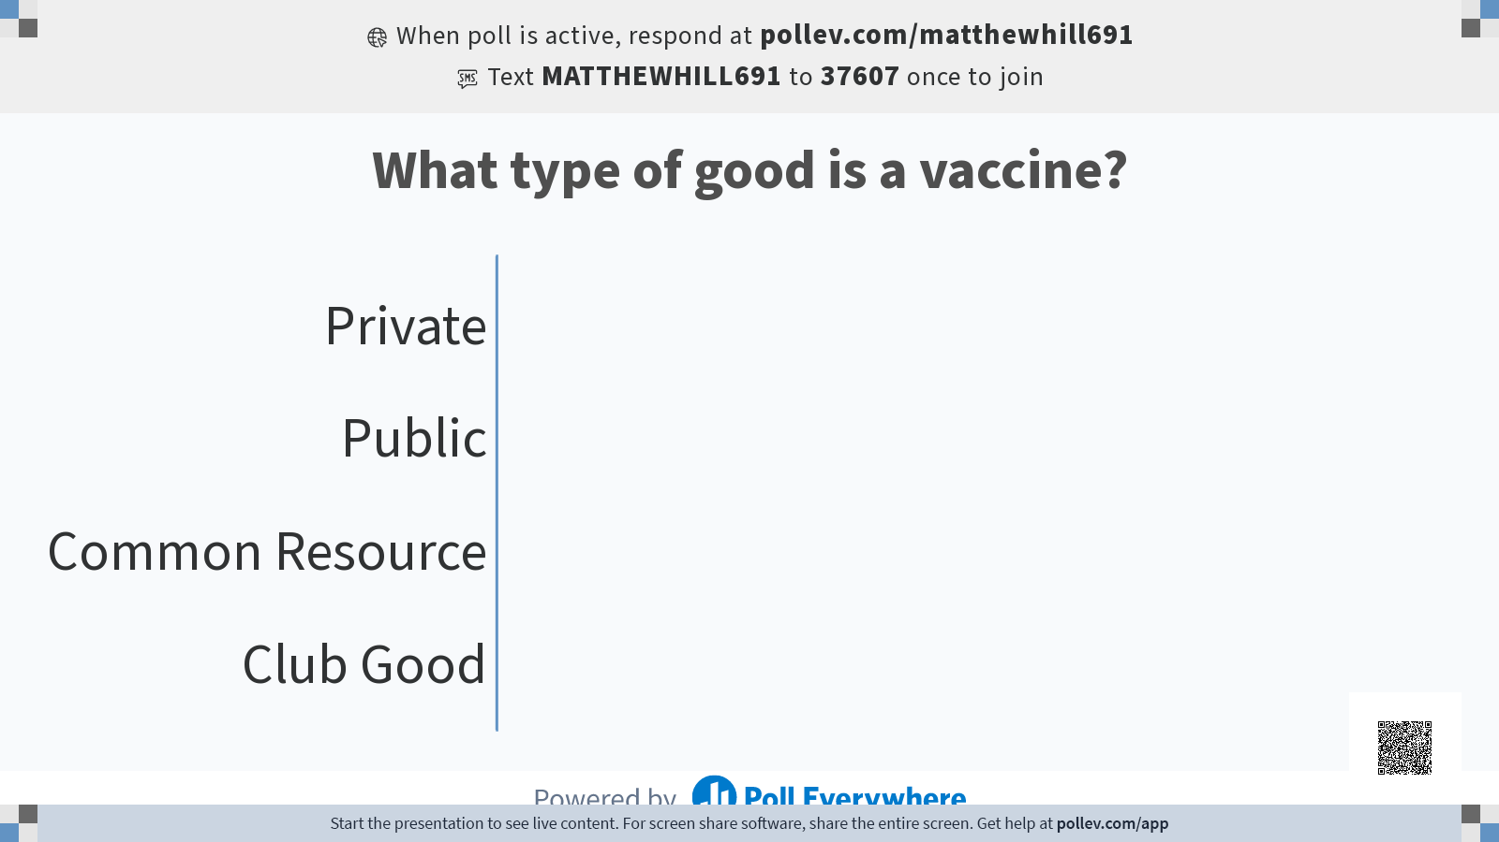

Slide 23
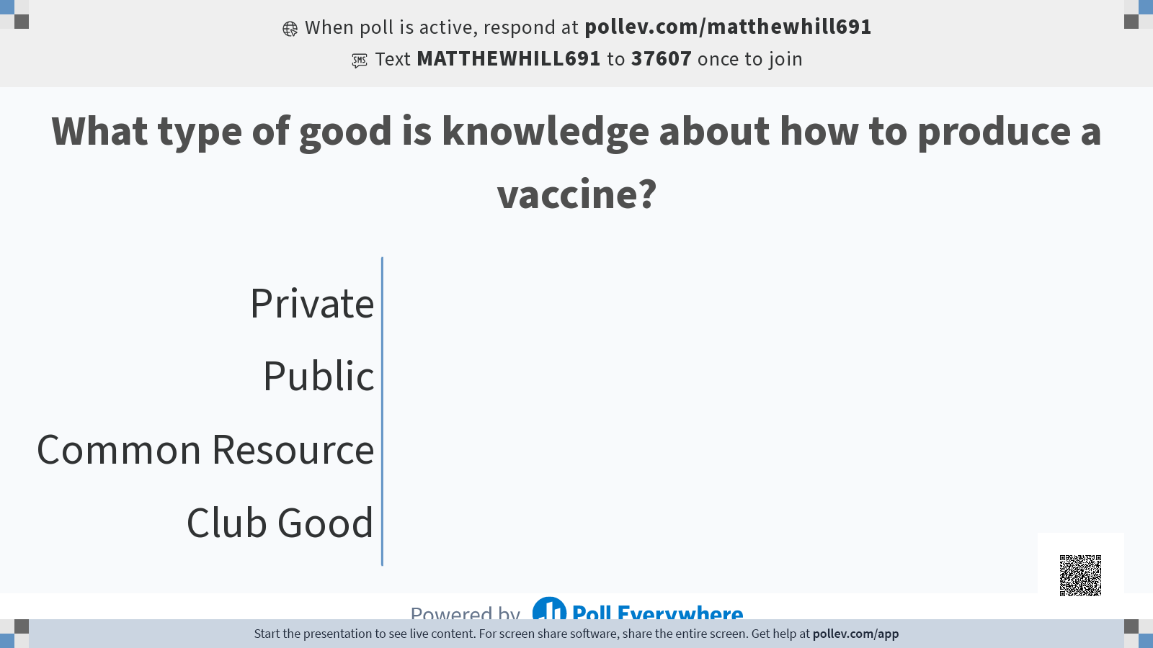

Slide 24
Public Goods
The educational service provided by public schools is not a public good according to our definition. Education is both rival and exclusive.
Remember:
Public goods are different than goods provided by the government for the public “good.” Vaccines and education are NOT public goods.
But both provide a significant level of positive externalities, hence government provision

Slide 25
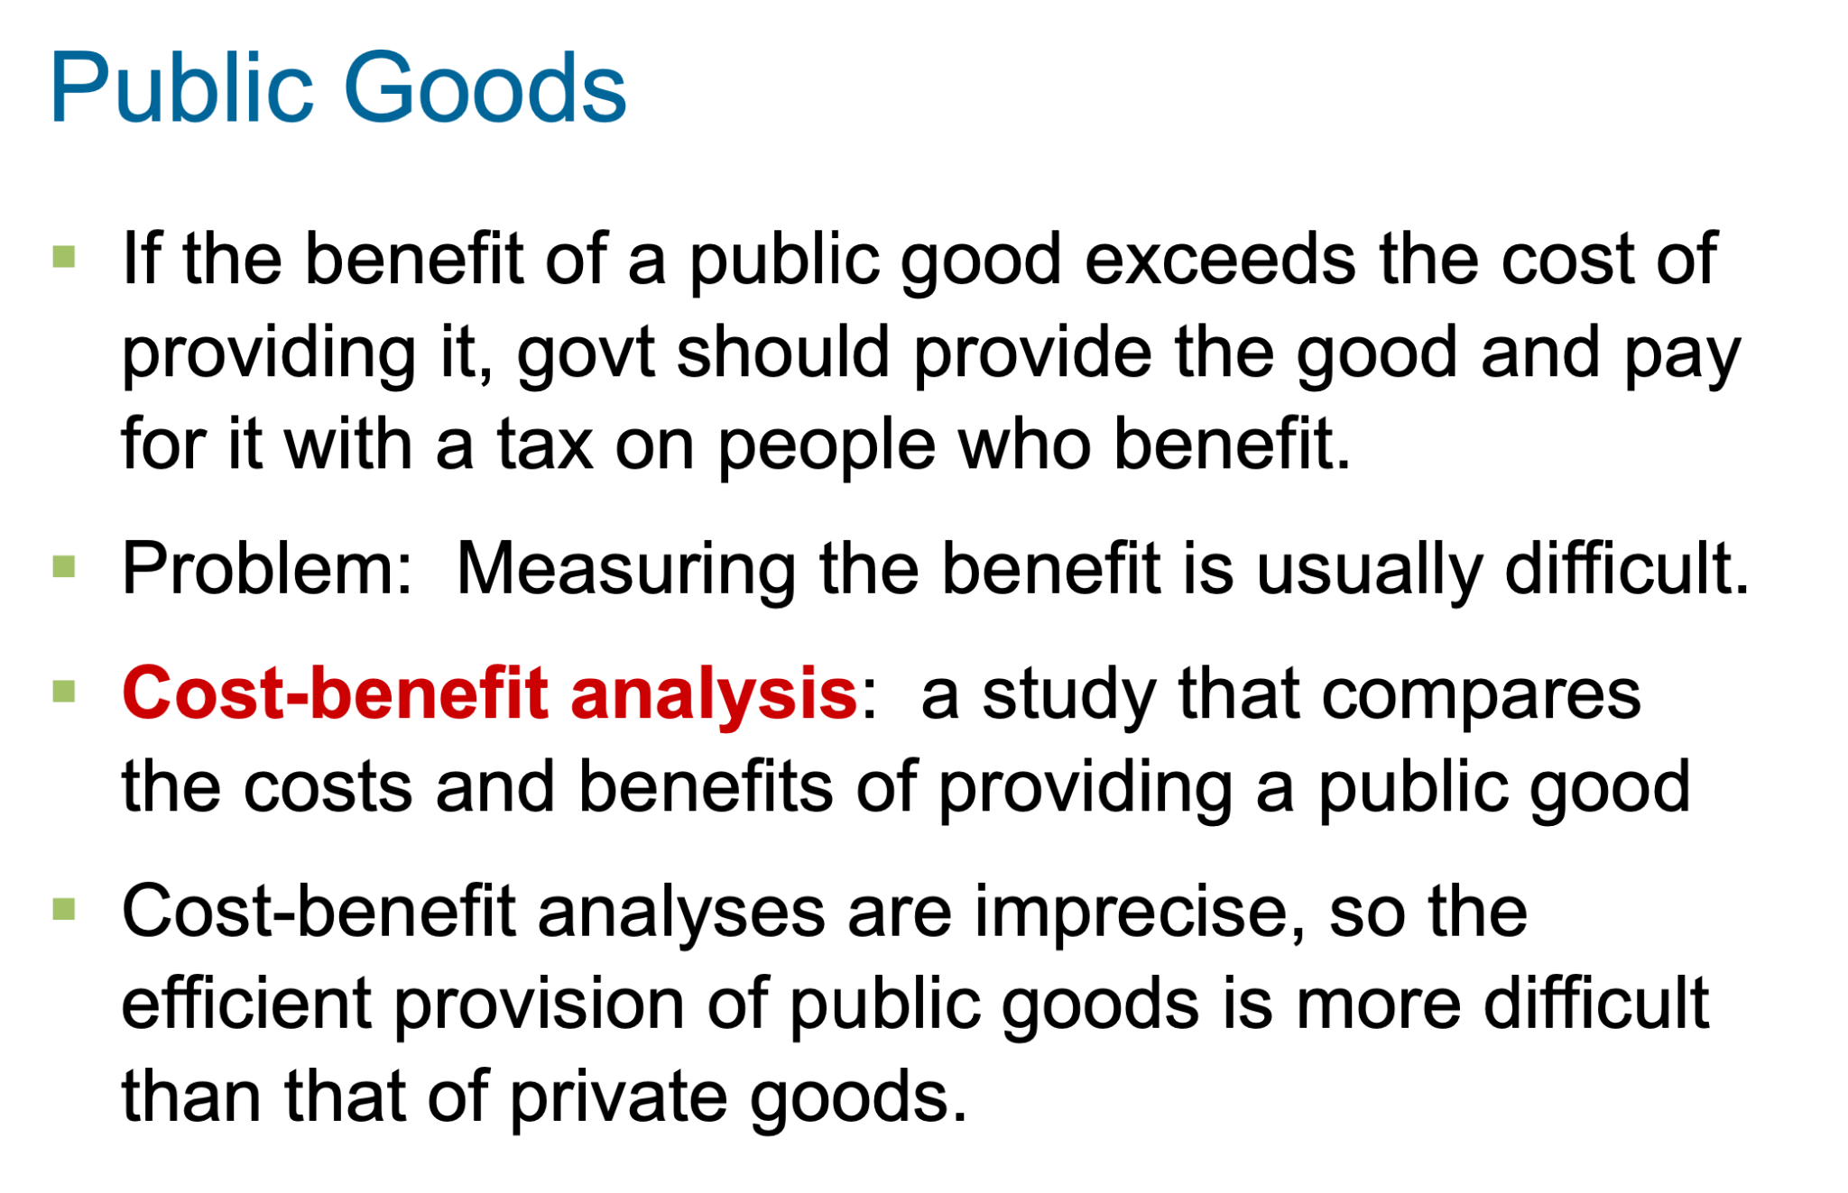

Slide 26
Common Resources

Slide 27
The Different Kinds of Goods
 | Excludable | Not Excludable
Rival | Private Goods | Common Resources
Non-Rival | Club Goods | Public Goods

Slide 28
Common Resources Real life Examples
Restaurant Ketchup
Coffee shop Wi-fi
Right to call people
Common rooms in dorms
Other examples?
Notes:
‹#›
This case study is not in the textbook.

Slide 29
Some Important Common Resources
Congested roads
Oil, minerals
Fish, whales, and other wildlife
Notes:
‹#›

Slide 30
Common Resources
Like public goods, common resources are not excludable.
  Cannot prevent free riders from using
  Little incentive for firms to provide
  Role for govt: seeing that they are provided
Additional problem with common resources:
rival in consumption.
  Each person’s use reduces others’ ability
  to use
  Role for govt: ensuring they are not overused
Notes:
‹#›

Slide 31
The Tragedy of the Commons
A parable that illustrates why common resources get used more than is socially desirable.
Setting: a medieval town where sheep graze on common land.
As the population grows, the # of sheep grows.
The amount of land is fixed,
the grass begins to disappear from overgrazing.
The private incentives (using the land for free) outweigh the social incentives (using it carefully).
Result: People can no longer raise sheep.
Notes:
‹#›

Slide 32
The Tragedy of the Commons
The tragedy is due to an externality:
Allowing one’s flock to graze on the common land reduces its quality for other families.
People neglect this external cost, resulting in overuse of the land.
Notes:
‹#›

Slide 33
Policy options for common resources
What could the townspeople
(or their government)
have done to prevent the tragedy?
Try to think of two or three options.
© 2015 Cengage Learning. All Rights Reserved. May not be copied, scanned, or duplicated, in whole or in part, except for use as permitted in a license distributed with a certain product or service or otherwise on a password-protected website for classroom use.
Notes:
If you’re pressed for time, you can safely omit this exercise. Its contents will be covered in a subsequent slide, and students can learn this material from a careful reading of the chapter.
This exercise has several objectives:
1) It gets students to anticipate the policy solutions to the common resource problem based on what they have just learned about the problem.
2) After giving students a big hint on the preceding slide, it tests to see whether they make the connection between the common resource problem and the policies to deal with negative externalities they learned in the preceding chapter.
To get through this activity quickly, display the question, give students a quiet moment to formulate their responses, then ask for students to share their answers.
If you can spare an extra couple of minutes, have them work in pairs—two minutes should suffice—and then ask students to share their answers with the class.

Slide 34
Answers
Impose a corrective tax on the use of the land
to “internalize the externality.”
Regulate use of the land (the “command-and-control” approach).
Auction off permits allowing use of the land.
Divide the land, sell lots to individual families; each family will have incentive not to overgraze its own land.
© 2015 Cengage Learning. All Rights Reserved. May not be copied, scanned, or duplicated, in whole or in part, except for use as permitted in a license distributed with a certain product or service or otherwise on a password-protected website for classroom use.
Notes:
All of these policy options have been used in modern times to deal with the common resource problem. The following slide shows a few examples.

Slide 35
Policy Options to Prevent
Overconsumption of Common Resources
Regulate use of the resource.
Impose a corrective tax to internalize the externality.
  Example: hunting & fishing licenses,
  entrance fees for congested national parks
Auction off permits allowing use of the resource.
  Example: spectrum auctions by the
  U.S. Federal Communications Commission
If the resource is land, convert to a private good
by dividing and selling parcels to individuals.
Notes:
‹#›
The electromagnetic frequency spectrum is a common resource.
It is not excludable: anyone with the right equipment can use it.
It is rival in consumption: there’s a limited amount of spectrum available.
The U.S. FCC has been auctioning licenses to use parts of the spectrum since 1994. These auctions raise substantial revenue for the federal government and help allocate spectrum efficiently (firms that can use it most productively bid the most in the auctions).

Slide 36
Policy Matters: Tale of Two Inventors
Before regulation, the Radio spectrum is an example of a common resource.
Non-excludable (anyone can broadcast)
Rival (if people are broadcasting on same frequency causes interference)
Notes:
‹#›
The electromagnetic frequency spectrum is a common resource.
It is not excludable: anyone with the right equipment can use it.
It is rival in consumption: there’s a limited amount of spectrum available.
The U.S. FCC has been auctioning licenses to use parts of the spectrum since 1994. These auctions raise substantial revenue for the federal government and help allocate spectrum efficiently (firms that can use it most productively bid the most in the auctions).

Slide 37
Policy Matters
https://www.youtube.com/watch?v=ZiwSRmOhzy0&list=PLnWzmi-aXGQCRcGeA7ih8BR93eK3zqKll&index=3

